Slide 1
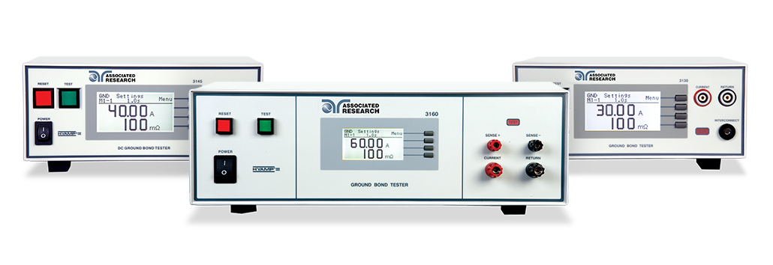
Ground Bond and
Ground Continuity Testing

Slide 2



Meet Our Team
Anthony Arroyo
Bishan Patel
Allison Oba
Presenter
Applications Engineer
Panelist
Applications Engineer
Organizer
Marketing Assistant

Slide 3
Webinar Notes
  Please use the Q & A utility to ask us any questions concerning
  the material being presented.
  Any questions related to running of the meeting (audio and
  visual, etc) can be addressed to the host (Allison Oba) through
  the chat line.
  The Webinar is being recorded and will be available to view usually within a day on our website.
  Please contact Allison Oba - chat line or email allison.oba@arisafety.com if you would like a copy of the presentation.

Slide 4
Previous Webinar Recap – Hipot Testing 102
AC vs DC
Testing
• Reactive vs Real Current
• Pros & Cons of AC vs DC
500 VA Hipot
Testing
• What is 500VA Testing?
Line vs Load Regulation
Features
• Smart GFI/Interlock/Prompt and Hold
• Line vs Load Regulation
Parameters
• Setting Hi and Low Limits
• Offsets

Slide 5
Ground Bond & Ground Continuity Testing
Learning Objectives
Ground
Grounding of electrical products
Ground Bond
The Ground Bond Test – What is it?
Ground Continuity
The Ground Continuity Test – What is it?
Bond Vs. Continuity
Comparing the Ground Bond and Ground Continuity tests
Class I vs. Class II products
What is Ground?
Ground Bond Testing Examples
Ground Continuity Testing Examples
Ground Bond Standards Information
Ground Continuity Standards Information
Example of Ground Bond vs Ground Continuity
Notes:
Important to understand what a groun

Slide 6
What is Ground?
Reference point for an electrical circuit
Second line of defense against electrical shock¹
Common return path for electrical current²
Ground or “earth” can have numerous functions and meanings. The main purpose of a ground is to reduce the risk of electrical shock.
1 – http://en.wikipedia.org/wiki/Ground_%28electricity%29#mediaviewer/File:HomeEarthRodAustralia1.jpg
2 - http://www.howequipmentworks.com/physics/electricity/elec_safety/electrical_safety.html

Slide 7
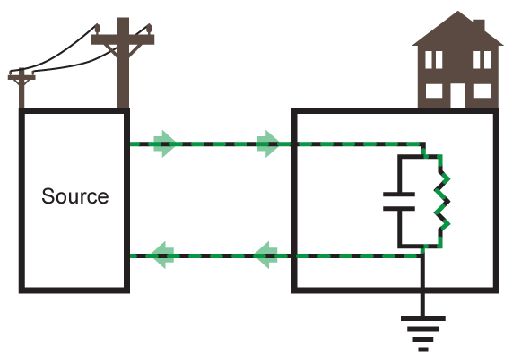
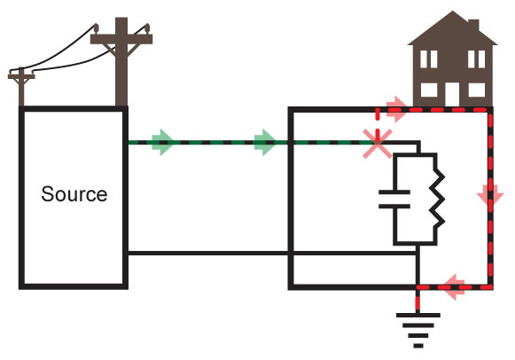
Modern Power Distribution

Slide 8
Different Functions of Ground
Service Ground
Equipment Ground
Ground or “Earth”
System or Service ground – designed to protect machines, tools and insulation.
Equipment Ground – Designed to protect operator from electrical shock hazards.

Slide 9
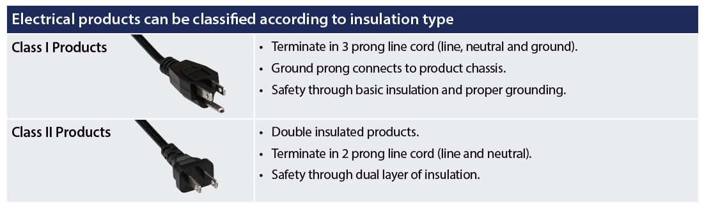
Class I vs. Class II Electrical Products
Class I products provide electrical protection by employing basic insulation and a grounded chassis. Class II products employ a double layer of insulation so a grounded chassis is not necessary.

Slide 10
What is Good Ground?
National Electrical Code
• NFPA 70
• Protect people and property from electrical hazards
NEC 250-45
• ”Any exposed non-current carrying metal parts of cord & plug connected equipment which may become energized shall be grounded.”
NEC 250-51
• Permanent and Continuous
• Capacity to conduct fault current
• Low impedance to limit voltage to ground.
NFPA (National Fire Protection Agency) stipulates the NEC which is adopted in all 50 U.S. States. The NEC gives requirements for grounding products and installations. The NEC defines a “good” ground.

Slide 11
Ground Bond and Continuity Tests
Purpose
• Ground Bond and Ground Continuity tests are designed to “check” the ground connection on a product or system.
• How you ensure you have a proper ground.
Method
• Apply a current to the ground point of a product or system.
• Measure potential drop across the ground circuit and calculate the circuit resistance.
Testing
• Ground Bond are generally TYPE TESTS.
• Ground Continuity are generally PRODUCTION TESTS.
These two types of tests are used to prove and verify that there is a low impedance path to the ground for electrical products and systems. This ensures proper grounding.

Slide 12
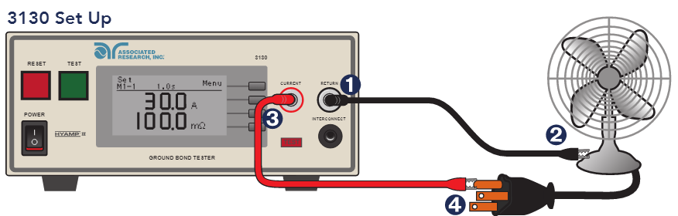
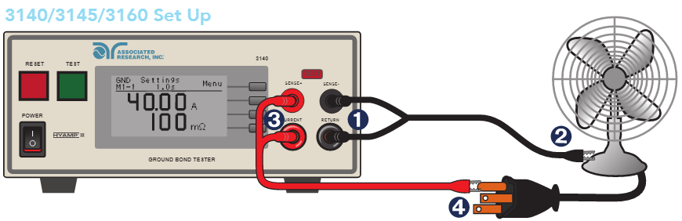
The Ground Bond Test
Associated Research Inc. HYAMP connected to
a DUT (Device Under Test)

Slide 13
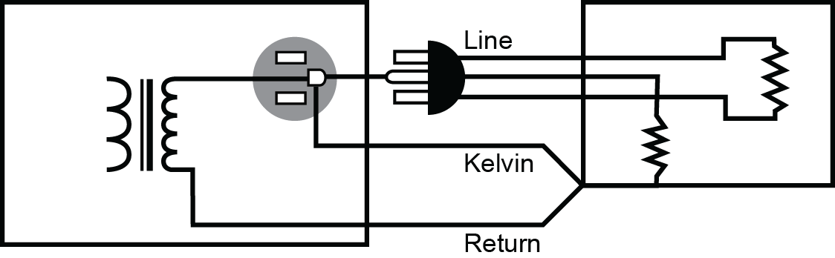
Ground Bond Testing

Slide 14
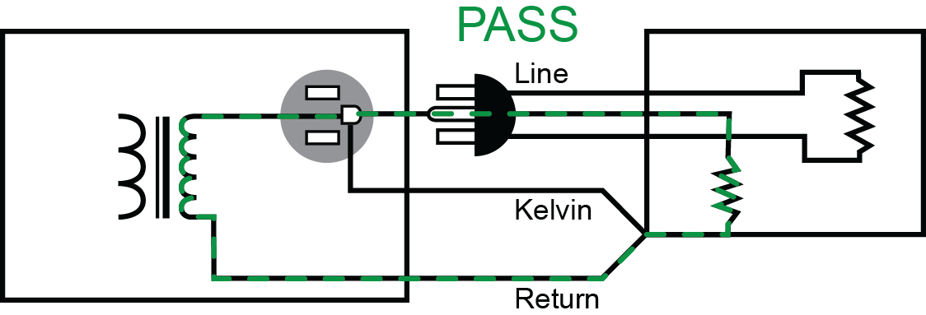
Ground Bond Testing

Slide 15
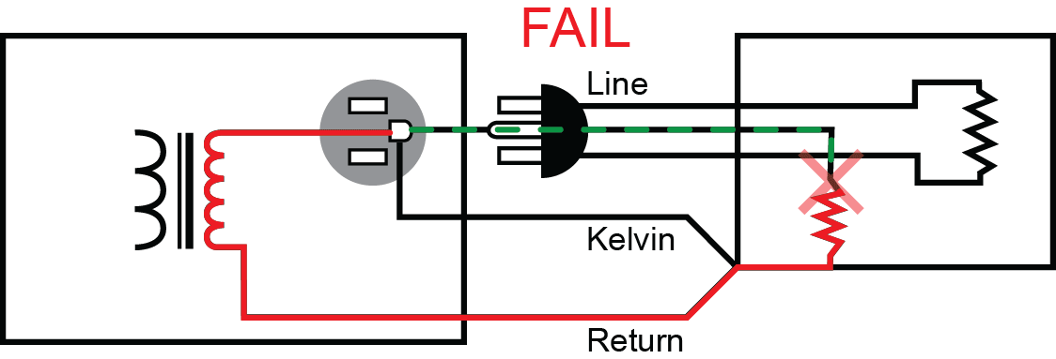
Ground Bond Testing

Slide 16
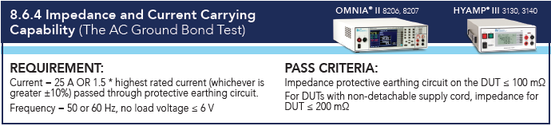
By the Numbers – What the Standards State
IEC/UL 60601-1 3rd Edition

Slide 17
Poll Question 1

Slide 18
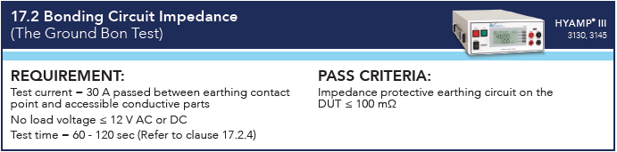
By the Numbers – What the Standards State
UL 1598/CSA C22.2 No. 250.0-08
3rd Edition - Luminaires

Slide 19
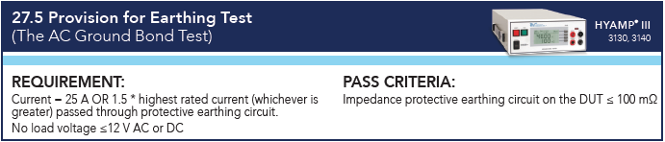
By the Numbers – What the Standards State
IEC/UL 60335-1 5th Edition

Slide 20
Ground Continuity Testing
Definition
• A DC low current test to check circuit resistance.
• Similar concept to the Ground Bond testing.
Method
• Not all readings display an Ohmic value.
• Light/buzzer meters to check whether continuity exists.
Ground Continuity testing is the same concept as Ground Bond testing. You’re simply checking for a continuous path on a ground circuit. However, there are key differences between these two tests.

Slide 21
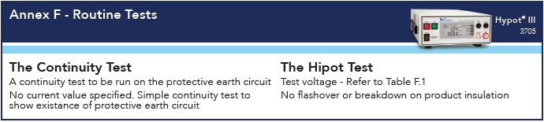
By the Numbers – What the Standards State
IEC/UL 61010-1 3rd Edition

Slide 22
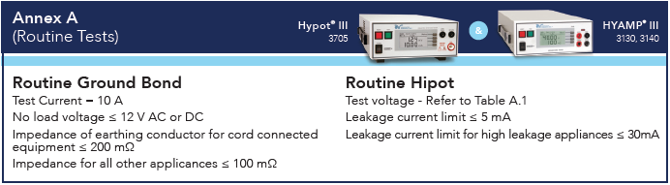
By the Numbers – What the Standards State
IEC/UL 60335-1 5th Edition

Slide 23
Ground Bond Vs. Ground Continuity
Ground Continuity Test | Ground Bond Test
• Verifies the existence of a ground connection • Readings generally given in Ωs • The test is quick to set up and easy to perform • Usually used as an extra feature during the Hipot test. | • Verifies the integrity of a ground connection • Readings generally given in mΩ • Provides more valuable safety information about DUT • Can be combined with a Hipot test for a more complete safety testing system.
The Ground Bond test is more stringent than
the Ground Continuity test.

Slide 24
Ground Bond Vs. Ground Continuity
Example: 64 strand wire with all but one strand connected.

Slide 25

Ground Bond Vs. Ground Continuity
Example: 64 strand wire with all but one strand connected. A ground continuity test would pass this wire because the instrument reads a continuous path.

Slide 26

Ground Bond Vs. Ground Continuity
Example: A Ground Bond test load the wire with high current. This would “burn up” the connection and cause a FAIL.

Slide 27

Ground Bond Testing Video Demonstration

Slide 28
Summary: Ground Bond Vs. Ground Continuity
Ground
Grounding of electrical products
Ground Bond
The Ground Bond Test – What is it?
Ground Continuity
The Ground Continuity Test – What is it?
Bond Vs. Continuity
Comparing the Ground Bond and Ground Continuity tests
Class I vs. Class II products
What is Ground?
Ground Bond Testing Examples
Ground Continuity Testing Examples
Ground Bond Standards Information
Ground Continuity Standards Information
Example of Ground Bond vs Ground Continuity
Notes:
Important to understand what a groun

Slide 29
JOIN US FOR OUR
NEXT WEBINAR
Wednesday, June 22nd 10AM CST (GMT – 6:00)
Leakage Testing 101
Click the link in chat box to learn more
Notes:
Insert next webinar info here

Slide 30



Contact Us
If you would like a copy of this presentation please contact Allison Oba at allison.oba@arisafety.com
Check out our website for more information arisafety.com
Follow Us!
Associated Research, Inc.
@ARHypot

