Slide 2
Safe Workstation Review for Electrical Safety Testing
SYED ABIDI
Associated Research Inc.
July 22nd, 2015

Slide 3
Webinar Notes
Please use the Q & A utility to ask us any questions concerning the material being presented.
Any questions related to running of the meeting (audio and visual, etc) can be addressed to the host (Allison Oba) through the chat line.
The Webinar is being recorded and will be available to view usually within a day on our website.
Please contact Allison Oba - email allisono@arisafety.com if you would like a copy of the presentation.

Slide 4
Previous Webinar Recap – Electrical Safety Testing 201
Testing with Multiplexers
Batch testing
Data Collection
Collecting and managing data
Software control and remote operation
Common Electrical Safety Tests
Hipot testing
Ground Bond/Ground Continuity testing
Touch Current testing
Label printing
Methods of data acquisition

Slide 5
Safe Work Station – Learning Objectives
Operator
10 Things a Qualified Operator Should Know
Building Safeguards
Stations with positive protection
Additional Safety Methods
Additional means for safe testing
Safety
What is safety and why do we test?
Shock Hazards
Effects of Current on the Human Body
Station without positive protection
Training Resources

Slide 6
Safety Matters
Product Safety
Device
Operator Safety
The condition of being safe from undergoing or causing hurt, injury or loss
A device or a machine designed to prevent inadvertent or hazardous operation

Slide 7
Severity of Electric Shock Is Influenced by:
Physical condition & response.
The path of the electrical current through the body.
The duration or length of time the person is exposed.
The magnitude of the voltage and current flow.
The frequency of the supply voltage.

Slide 8
Potential Shock Hazards
Contact is made with one point of a circuit and ground.
Contact is made with a “hot” metallic part while a person is at ground potential.
Contact is made with two points of a circuit.

Slide 9
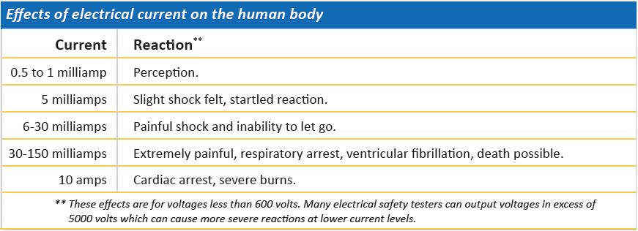
Effects of Electrical Current on the Body

Slide 10
Human Body Resistance
The human body on an average has about 1000 to 1500 ohms resistance to the flow of electrical current.
The outer layer of the skin provides the largest resistance.
The skin has a breakdown voltage at which it is simply “punctured” leaving only the lower resistance body tissue to impede the flow of current in the body.

Slide 11
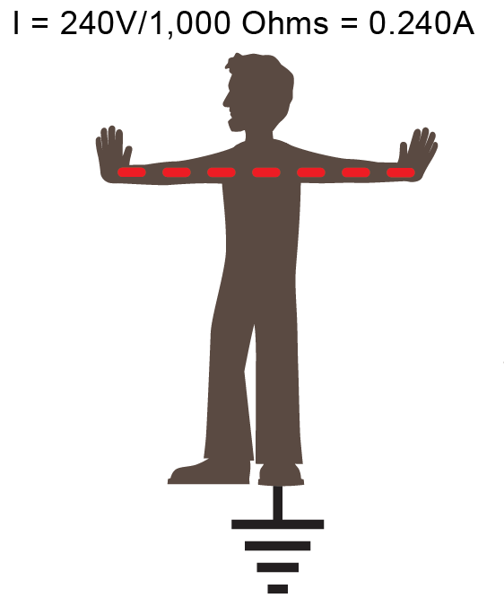
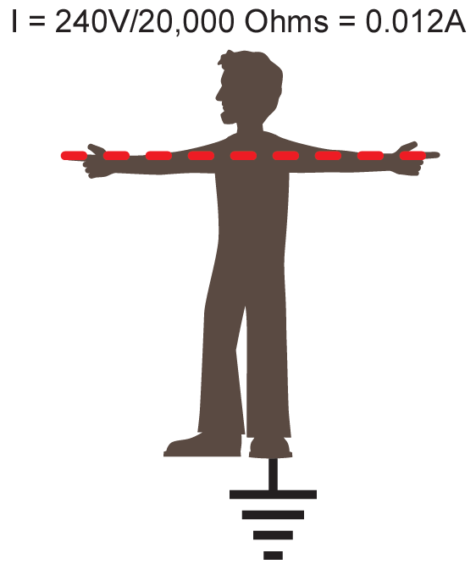
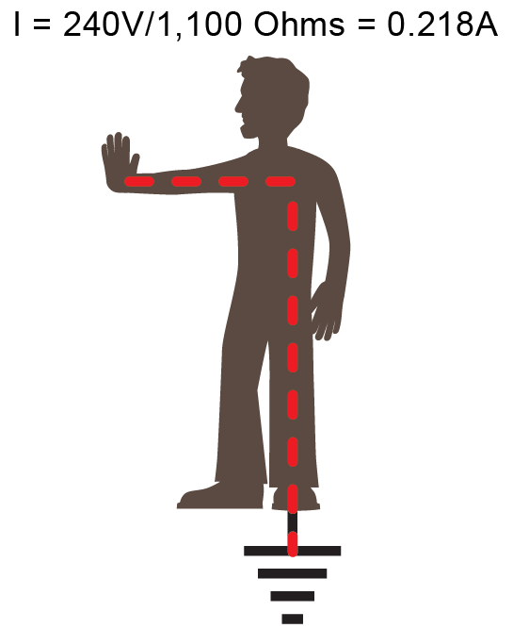

Slide 12
Poll Question
Do you use ESD Mats or Smocks at your Electrical Safety Testing Station?

Slide 13
The Qualified Test Operator – 10 Things to Know
1. Determine if exposed conductor is energized
2. Know how to use the
equipment. Read the specs!

Slide 14
The Qualified Test Operator – 10 Things to Know
3
Understand approach distances and corresponding voltages
AR instruments can output 10 – 20,000 VAC or VDC
4
Understand the relationship between electrical hazards and possible injury
Effects of electrical current on the human body
5
Know the safety features of the equipment and how to utilize them.
SmartGFI, Interlock and automatic discharge.

Slide 15
The Qualified Test Operator – 10 Things to Know
6. Determine if PPE is necessary, what type and how it’s rated.
7. Know the methods of release for victims who are being shocked. DO NOT TOUCH SOMEONE WHO IS BEING SHOCKED.

Slide 16
The Qualified Test Operator – 10 Things to Know
8
Understand that the tester is a variable voltage power source.
9
Know the importance of discharging the DUT.
There must be a complete path for an instrument to discharge. Be wary all leads are connected for testing.
10
Each step in a work plan must be executed.
DO NOT TAKE SHORTCUTS!
Contacting the DUT during the test can result in a dangerous shock hazard.

Slide 17
Building Safeguards into a Station
Cabling and insulation
Use PPE (Personal Protective Equipment)
Be aware of all nearby hazards
Enclosure designed to remove shock hazard

Slide 18
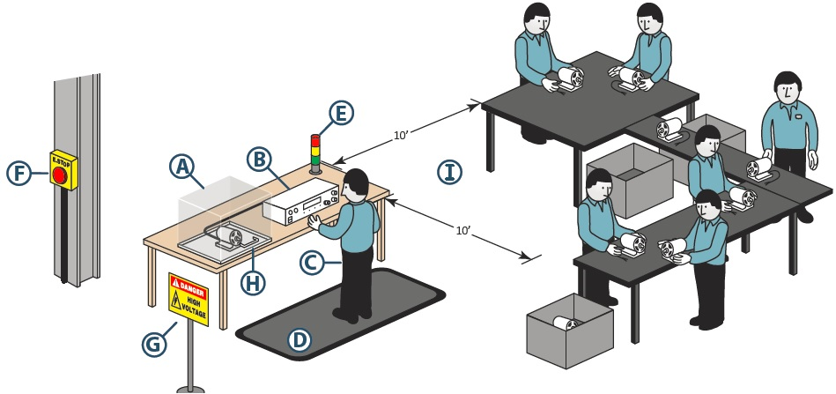
Methods of Safety Testing
Testing Station with Positive Protection

Slide 19
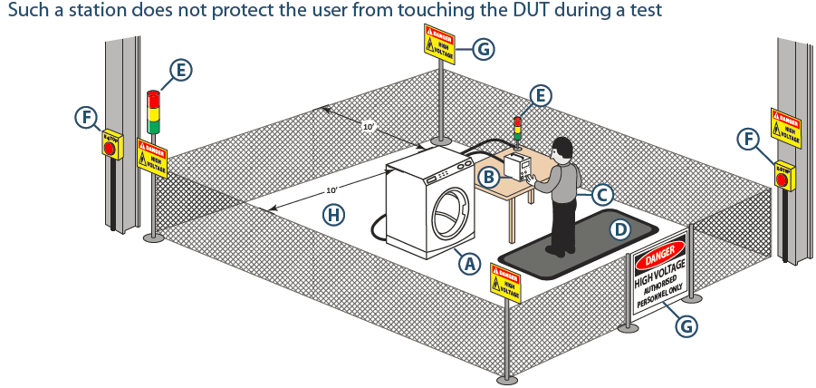
Methods of Safety Testing
Testing Station with NO Positive Protection

Slide 20
Poll Question
What kind of Workstation protection do you utilize?

Slide 21
Test Station with Positive Protection

Slide 22
Test Station without Positive Protection

Slide 23
Additional Methods for Operator Safety
Dual Remote Palm Switches
Simultaneous Activation
Activation of both within 0.5sec

Slide 24
Additional Methods for Operator Safety
Signal Lights
Illuminates Red when test is active
Mounted in plain site for entire work area

Slide 25
Additional Methods for Operator Safety
Insulation Mat
Isolates User From Ground Potential

Slide 26
Video Demonstration

Slide 27
Training Resources
OSHA 29 CFR part 1910.332 Subpart S
Defines the training requirements for anyone exposed to voltages in excess of 50 volts
Employees must be qualified to work on or near exposed energized parts
NFPA 70E: Standard for Electrical Safety in the Workplace 2012
Explains reason behind the rule and how to comply
Safe work practices, PPE and lockout/tagout procedures
BS EN 50191:2010
Erection and Operation of Electrical Test Equipment
Defines recommended setups for electrical testing stations

Slide 29
Contact Information
If you would like a copy of this presentation please contact Jim Kenesie at: allisono@arisafety.com
Check out the Associated Research website:
www.arisafety.com
Follow us on YouTube, LinkedIn and Twitter:
https://www.linkedin.com/company/associated-research-inc.?trk=biz- companies-cyf
http://www.youtube.com/user/ARHipot
https://twitter.com/ARHypot

